Slide 1
Automating routine tasks for the SQL Server data professional
Andy Mallon

Slide 2
Andy Mallon
Working with SQL Server since 2003 and SQL Server 2000
Background in Tech Support
Managed databases in many industries
Lazy
Impatient
Healthcare
Finance
E-Commerce
Non-Profit

Slide 3



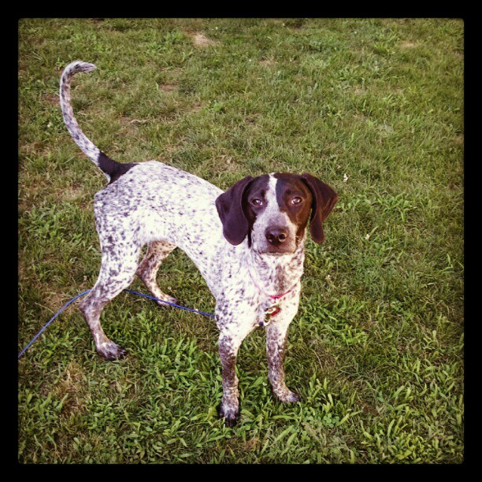
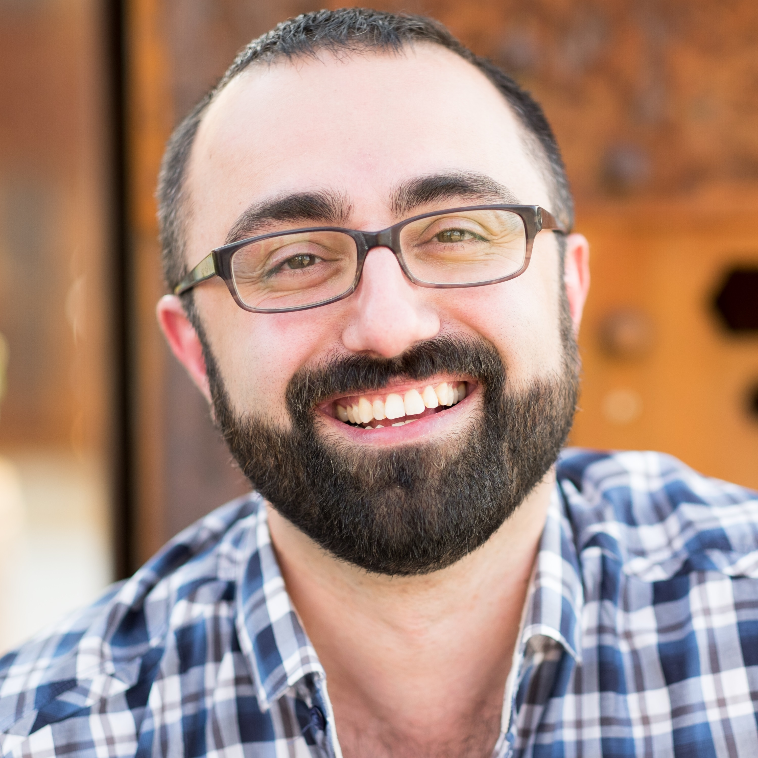


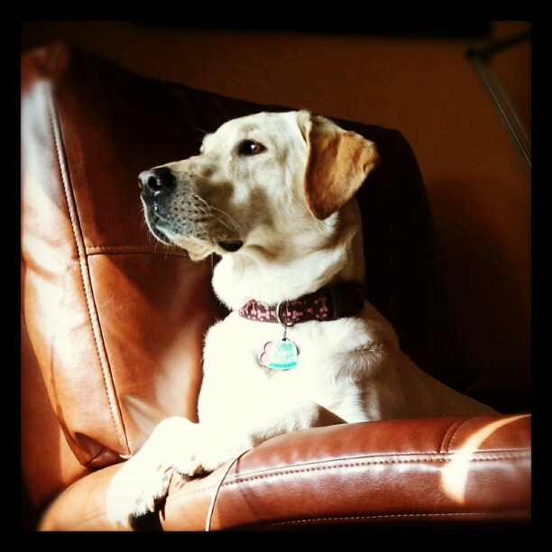
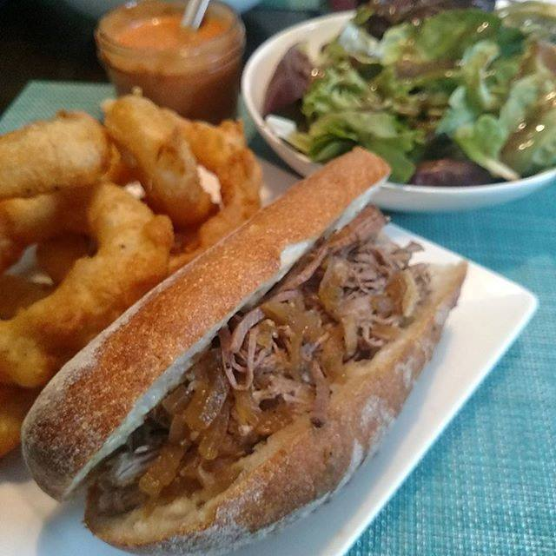



Notes:
Some of the things I love most in life– My husband, my pups, my food (I love to cook), and my city.

Slide 4


Contact Andy
Andy@AMtwo.co
@AMtwo
am2.co
andy@am2.co

Slide 5
Slides + Materials
Github.com/amtwo/presentations
@AMtwo
am2.co
andy@am2.co

Slide 6



Community Ambassador

Slide 7

Who uses Twitter?
Where the SQL Community hangs out
#sqlhelp
Free real-time help
Notes:
Who doesn’t want free advice from Brent Ozar or Aaron Bertrand?

Slide 8

Who uses Slack?
If nvarchar(140) isn’t enough
#sqlhelp #powershellhelp #ssrshelp
http://www.dbatools.io/slack for details
Notes:
Who doesn’t want free advice from Brent Ozar or Aaron Bertrand?

Slide 9

Session Feedback
Tell me what you don’t like
Tell me what can be better
Tell me what you like

Slide 10

I'm also gonna need you to go ahead and silence your cell phones
Yea…….You apparently didn’t put one of the new coversheets on your TPS reports.

Slide 11
What we’ll cover
Why automation is important
Identify tasks you should automate
Picking the right tool for the job
How I approach automation
Perform an install in one line of PowerShell

Slide 12
Before I start…
Who uses checklists?
Who has scripted those checklists?
Who is lazy?
Who is impatient?

Slide 13
Why is automation important?

Slide 14
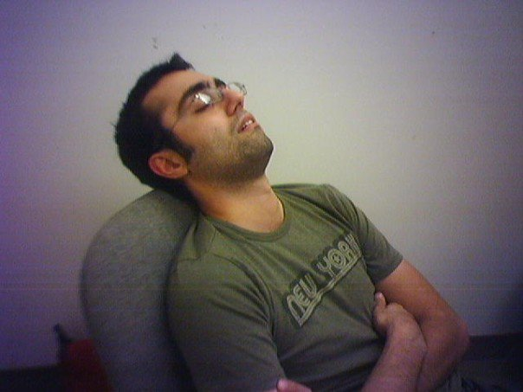
I’m lazy
Boring tasks are boring
Repetitive tasks are boring
I want to work smarter, not harder

Slide 15
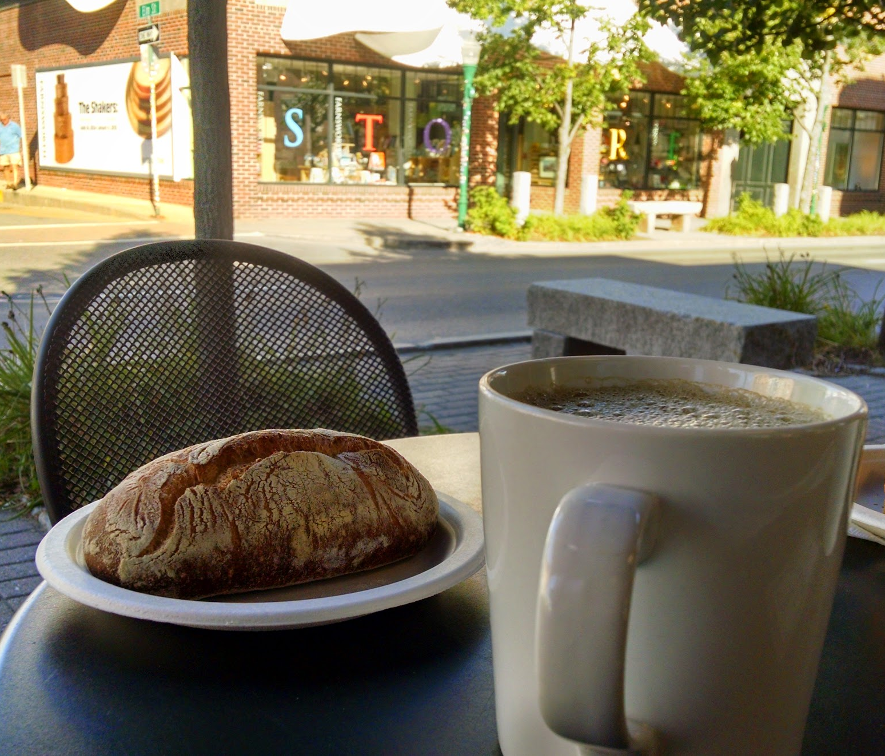
I’m busy
I have a lot of work to do
I like to relax on nights & weekends
I want to be bored

Slide 16
Busy is a four-letter word
Jes Borland – Session recording
https://am2.co/busy-is-a-four-letter-word
I want to be bored!

Slide 17
Checklists & Automation

Slide 18
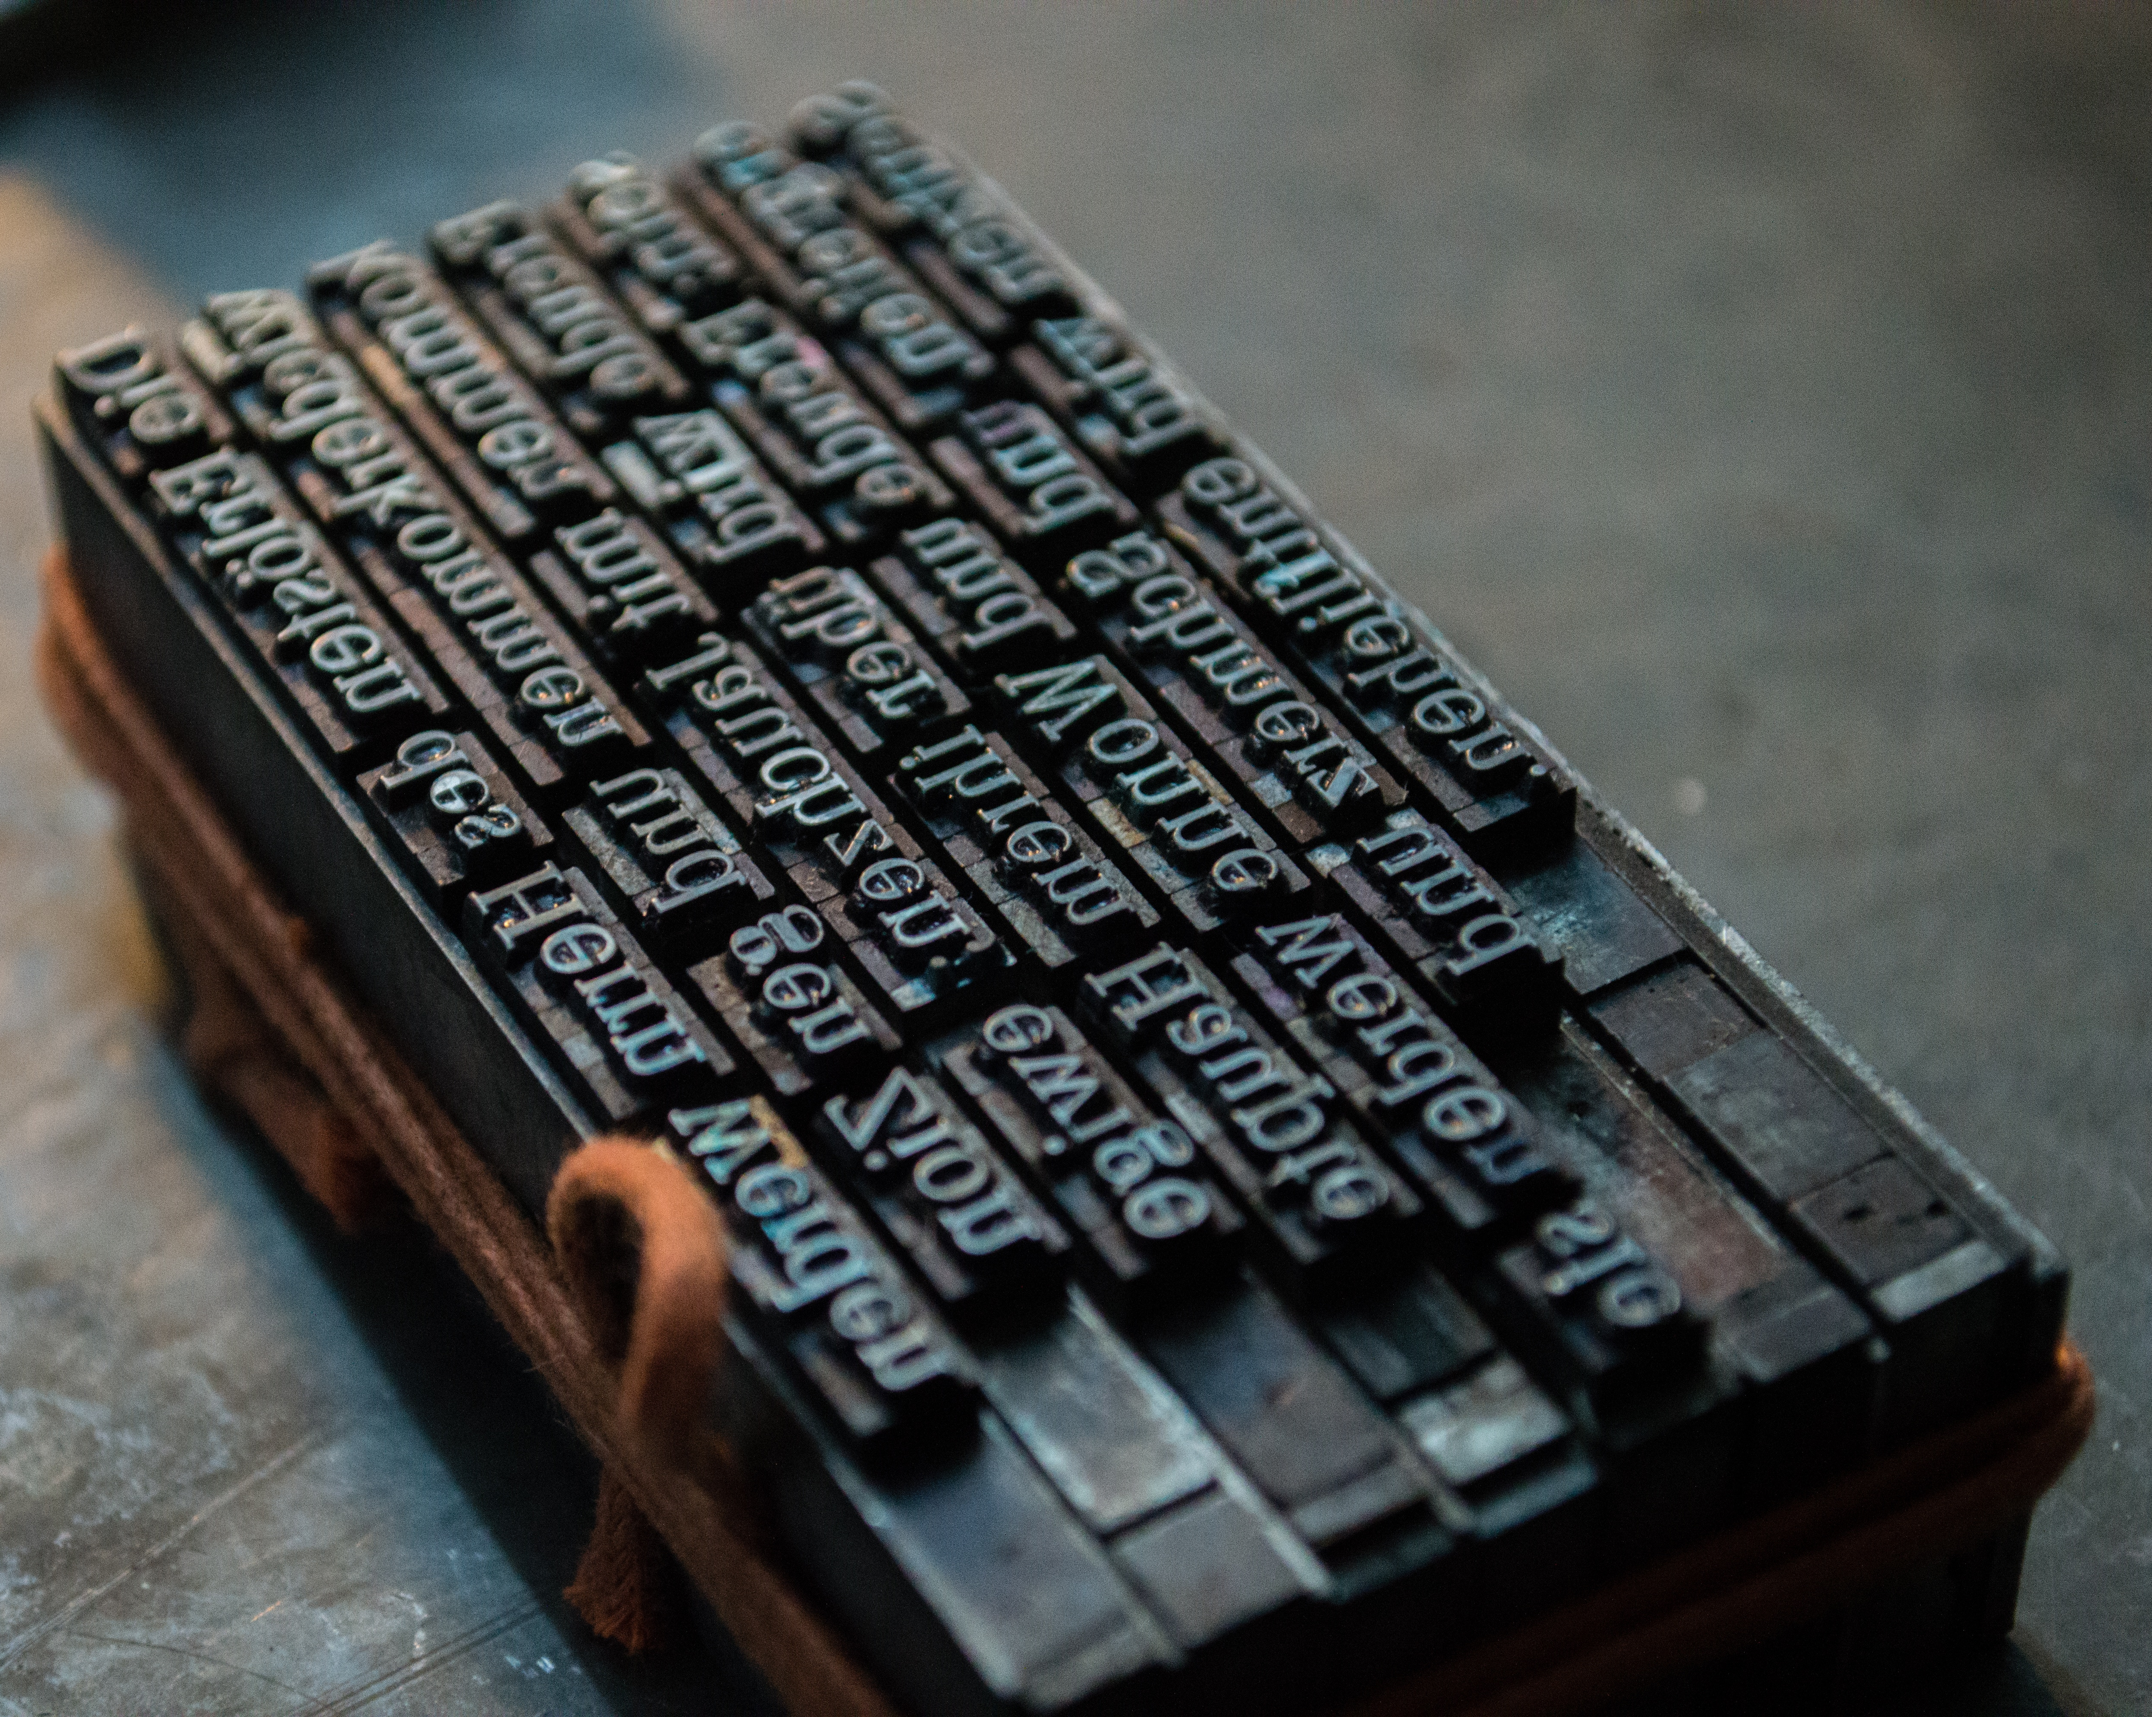
Consistency
Easier to troubleshoot problems
Easier to predict behavior

Slide 19
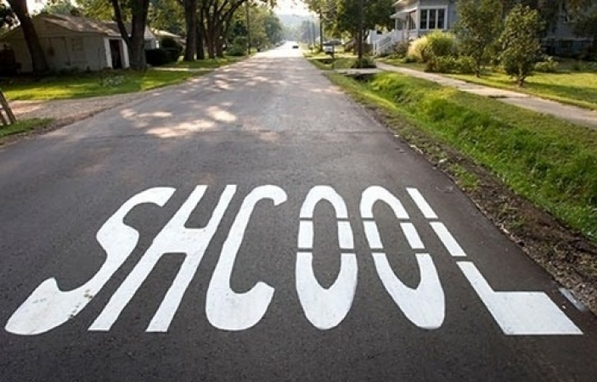
Consistency
Get things right every time
Get things wrong every time

Slide 20

The DBA is the Sheriff
We’re held accountable for the environment
Just because you can do something doesn’t mean you should
Learn to say “no”

Slide 21

Learn to say “no”
You can’t do everything
You can do more if you automate things
But you can’t automate everything
So you can’t do everything
Be nice about it
Use “No” to start the conversation

Slide 22

Standard build/config/process
The default
Everyone uses it unless they can’t
Basis for SLAs
You can have multiple “standards”

Slide 23

Exception build/config/process
Supported alternative
Known pitfalls
Maybe lessened SLAs

Slide 24
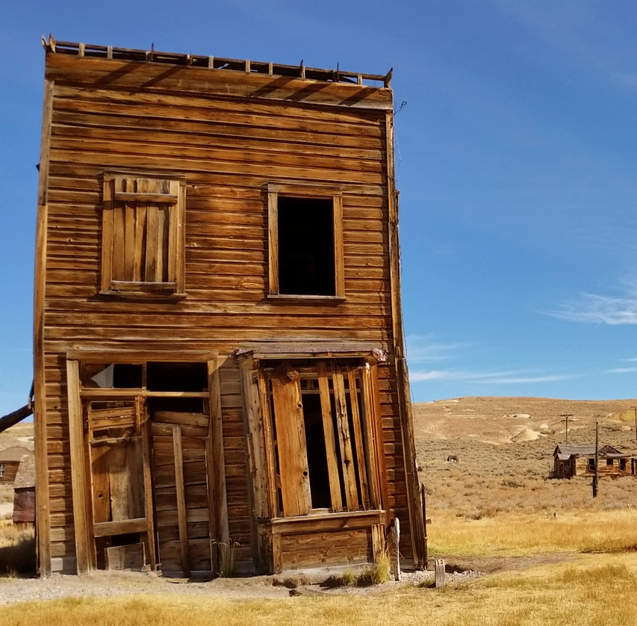
Prohibited build/config/process
Scenarios that aren’t allowed in your environment
Security
Industry Regulation
Lack of knowledge
Lack of money

Slide 25
Why automation?

Slide 26
Productivity
Do more faster
Less time on routine tasks
More time on unique tasks

Slide 27
Save time & money
Save on labor costs
Mitigate labor shortages
Increase your value to your employer

Slide 28
Improve quality
Humans make mistakes
Automation makes the same mistake repeatedly
Fixing automation fixes the error forever*
* For the specific case you coded a fix for. A different flavor of the problem might come back. Your fix is only as good as your code.

Slide 29
Improve transparency
Generate detailed logging
Make logs discoverable
Easier to research problems

Slide 30
Improve speed
Product releases are getting faster
Move faster without having to run
Faster results make happy customers

Slide 31
Standardization
Easier to identify problems
Easier to predict problems
Easier to prevent problems

Slide 32
What do I automate?

Slide 33
Don’t automate everything
Not everything can be automated
Not everything should be automated
Who is familiar with xkcd?

Slide 34
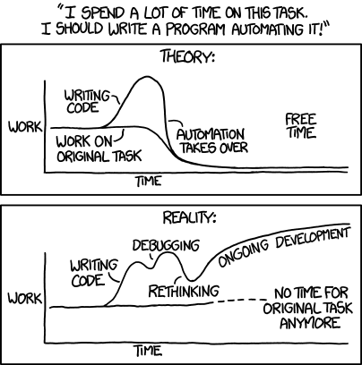
xkcd.com/1319 : Automation

Slide 35
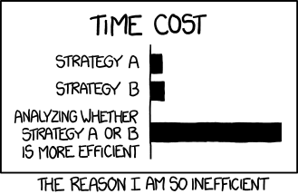
xkcd: Efficiency
xkcd.com/1445

Slide 36
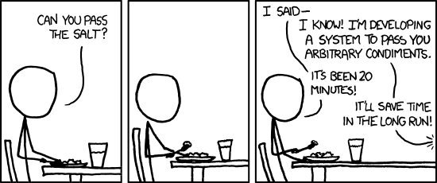
xkcd.com/974 : The general problem

Slide 37
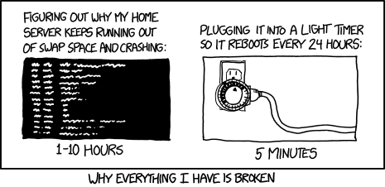
xkcd.com/1495 : Hard reboot

Slide 38
Fill in the blank
I have a ____________
and every once in a while it __________,
so I just ____________
because fixing this __________ is too hard.

Slide 39
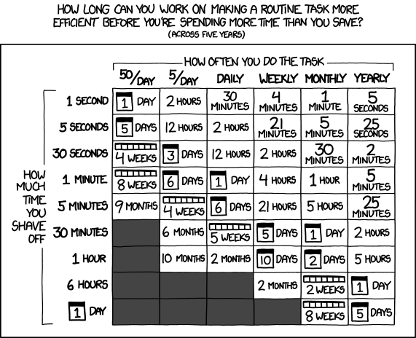
xkcd.com/1205 : Is it worth the time?

Slide 40
Picking the right tools

Slide 41
Some automation tools
T-SQL
PowerShell
Bash
SSIS
Python
.NET
Selenium
Jenkins
Puppet
Chef
Lambda functions
Azure Automation

Slide 42
Pick the right tool
T-SQL
PowerShell
Bash
SSIS
Python
.NET
Selenium
Jenkins
Puppet
Chef
Lambda functions
Azure Automation

Slide 43
Getting Started

Slide 44
Are you doing [task] already?
Develop a process
Develop a checklist
Start scripting individual steps
Save your scripts, stitch them together

Slide 45
SQL Install Automation

Slide 46
Install automation methods
ConfigurationFile.ini file
Setup.exe /param1 /param2
Both

Slide 47
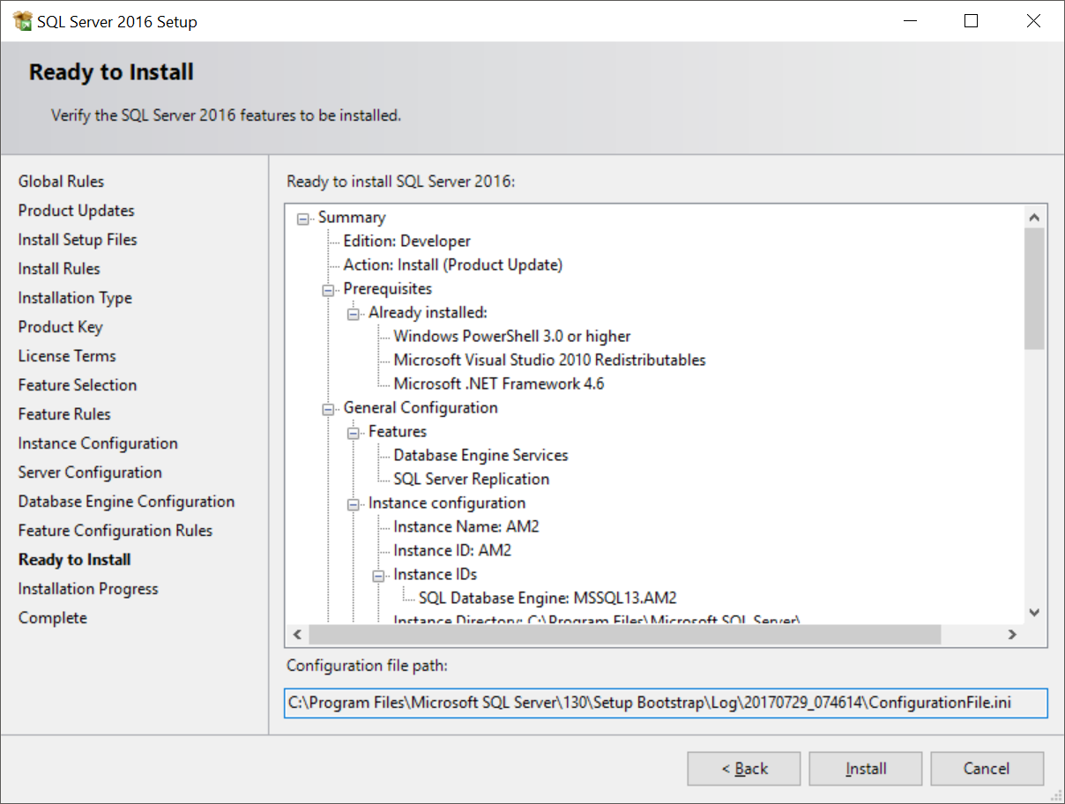
ConfigurationFile.ini

Slide 48
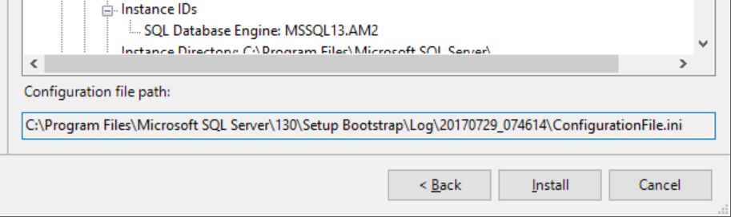
ConfigurationFile.ini

Slide 49
Demo

Slide 50
Questions?

